Slide 1


FactoryTwin / UT Dallas
AI Agent for Factory Analytics Platform
Illustrations copyrighted by FactoryTwin

Slide 2
Agenda
FactoryTwin company +platform overview
“Manufacturing 101”
FactoryTwin software demo
LLM Agent Requirements
Customer FAQs examples
Q&A

Slide 3

What We Do
FactoryTwin integrates and cleanses all sources of factory data—including ERP, PLM, QMS, spreadsheets, etc.—and builds a high fidelity model or the digital twin of the entire factory and its supply chain.
Provides descriptive and predictive insights into supply chain risks, capacity planning, cost reduction opportunities, and shop floor management
Allows users to experiment with different strategies like adjusting shift structures, cross-training operators, level-loading demand, etc., and see the projected impact on key KPIs
Mainly work with complex manufacturers such as Aerospace

Slide 4
Our Domain

Slide 5
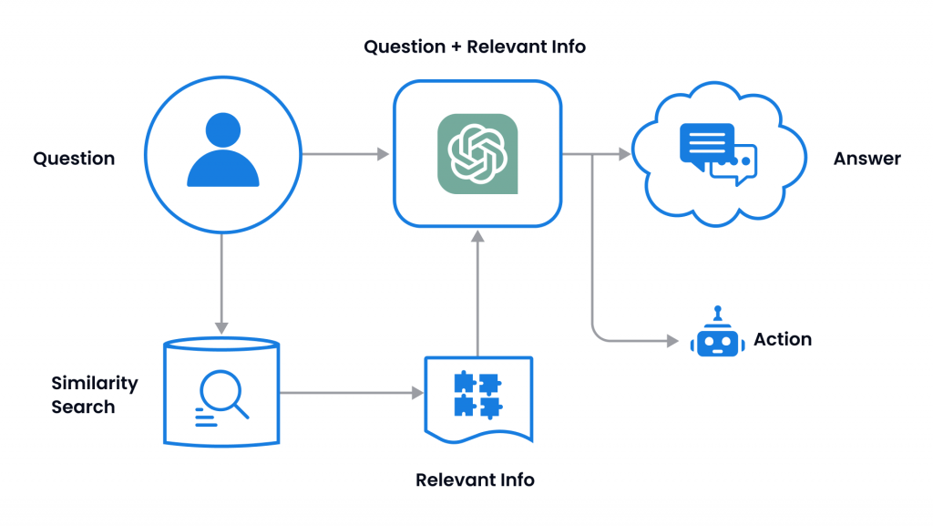

LLM Agent
Accepts natural language prompts from the user performs relevant actions for answering the prompt then ”textifies” the results and presents them back to the user
Agents can perform more complex tasks than just text completion, such as searching the web, querying data sources, and calling external APIs for further analysis
Most popular approaches uses LangChain, an open-source platform with support for various LLMs
LlamaIndex is also a popular support framework for data indexing and retrieval

Slide 6


LLM Agent Restrictions
Due to data security reasons, many manufacturers (especially in Aerospace and Medtech) don’t want their data anywhere near the internet, much less an AI on the internet
Due to the above restriction, the model must run locally and offline
Our software is deployed in an isolated container which is not always cloud-hosted, therefore the model must be small enough to run and deploy on a single machine
Llama 3 is a model we have successfully made use of in the past, and integrates well with LangChain and LlamaIndex

Slide 7

Customer FAQs
Some may be simple informational queries:
”How many operators are trained to run saws?”
“How many orders are due in the next week?”
“Which orders were shipped yesterday?”
Other queries may be asking for more complex information that may not be as simple to derive from the database:
“Which machines are going to be a bottleneck over the next 3 months?”
Others still may be asking for suggestions on what to do:
“How can I reduce labor cost for this part?”
“Which supplier is better to order this material from?”

